Slide 1

Careers in science and technology
People's Democratic Republic of Algeria
Ministry of Higher Education and Scientific Research
Badji Mokhtar University
LMD 1st Year Science and Technology Course

Slide 2
CHAPTER I

Slide 3
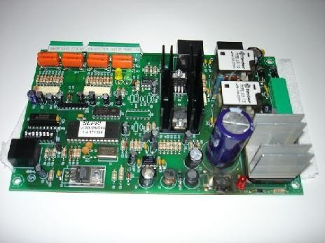
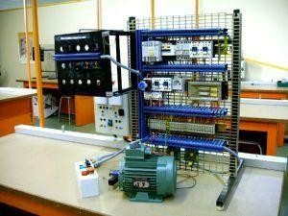
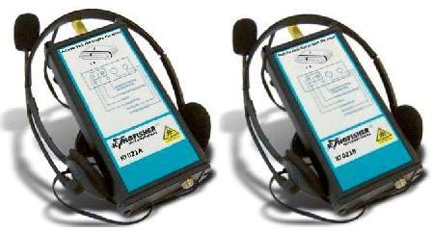
PROGRAMME: CHAPTER I
Careers in electronics, electrical engineering, communication systems, and new sensor technologies
Electronics and electrical engineering industry
Instrumentation and microsystems

Slide 4
PROGRAMME: CHAPTER I
Preamble
•Electronics have become ubiquitous in our daily lives:
•mobile phones,
•car equipment,
•computers,
•media players,
•household appliances.
•…….

Slide 5
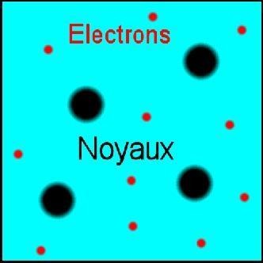
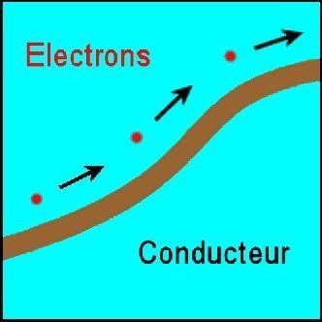
PROGRAMME: CHAPTER I
What is electronics?
Electronics is the science of controlling the movement of electrons.
Electronics is a branch of applied physics, dealing, among other things, with the shaping and management of electrical signals, enabling, for example, the transmission or reception of information. The adjective "electronic" also refers to anything related to the electron.
Ce qu'on appelle "courant électrique" n'est autre qu'un courant, un mouvement d'électrons. Ceux-ci peuvent circuler librement dans les corps dits conducteurs, tels que le cuivre qui est utilisé pour fabriquer les câbles électriques.

Slide 6
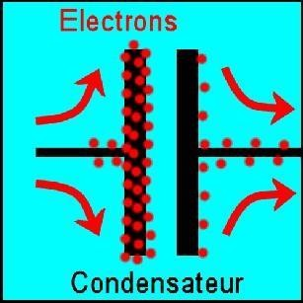
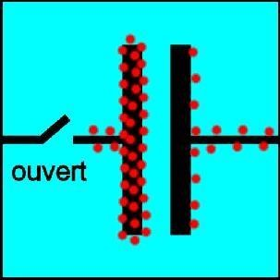
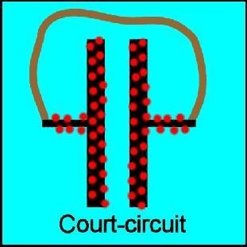
PROGRAMME: CHAPTER I
The electronic bases of memory
STATUS 1 STATUS 0
These are the memory states: 0 and 1.
Speed ​​of the electron around the nucleus: ~2000 km/s
~30 billion revolutions around the nucleus in 10⁻⁶ seconds

Slide 7
PROGRAMME: CHAPTER I
Careers in electronics
The professional fields that represent the trades of
electronics are found in the following areas:
Audiovisual and multimedia equipment
Computer equipment
Professional audiovisual equipment
Home comfort equipment (Domestic appliances)
Household appliances
Alarm and security equipment
Telecommunications and network equipment
Embedded electronic equipment
Observation, analysis, and measurement instrumentation equipment.
– ……….

Slide 8
PROGRAMME: CHAPTER I
Materials and current in electronics
The excellent conductivity of copper and its alloys explains its widespread use in the electronics industry. Copper allows electronic devices to operate faster, reduce heat generation, and last longer: in short, to achieve ever-higher performance.
Electronics is the quintessential domain for "low currents," where the intensity level is on the order of milliamperes.

Slide 9
PROGRAMME: CHAPTER I
What is electrical engineering?
Electrical engineering is the study of the technical applications of electricity; it is the discipline that studies the production, transmission, processing, transformation, and use of electrical energy.
Traditionally, electrical engineering is associated with "high currents" as opposed to "low currents," which are considered the exclusive domain of electronics.

Slide 10
PROGRAMME: CHAPTER I
Fields of application
It is extremely broad and concerns a great many industrial companies in the fields of:
electrical energy production and transmission (thermal power plants, nuclear power plants, solar power plants, wind farms, electricity transmission networks, transformer stations, etc.)
manufacturing of electrical equipment (electric motors, circuit breakers, contactors, switches, etc.)
Electrotechnics is closely linked to electronics and automation, which it frequently uses, particularly for motor control

Slide 11
PROGRAMME: CHAPTER I
Electrotechnical professions
The professional fields encompassing the electrotechnical trades include the following areas:
Electrical machinery (electric motors, generators, alternators, converters, etc.),
Voltage transformers,
Electrical networks (LV, MV, HV),
Energy storage (batteries, capacitors),
Electrical installation and safety equipment (meters, circuit breakers, disconnectors, electrical cables, etc.)
– ….

Slide 12
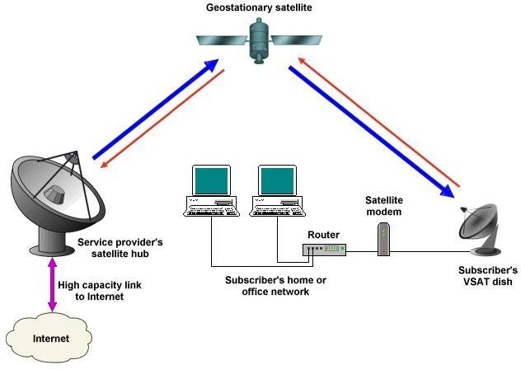
PROGRAMME: CHAPTER I
Communication systems

Slide 13

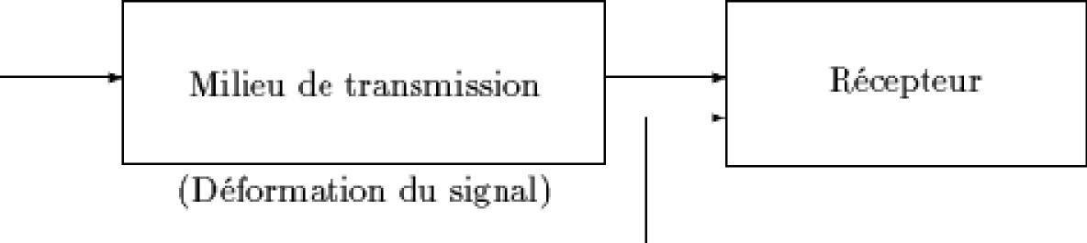
PROGRAMME: CHAPTER I
Function
A communication system's function is to ensure the transport of information between a transmitter and one (or more) receiver(s) connected by a communication channel or medium. This information is transported in the form of a signal. Examples of communication systems outside the field of computing include: the telephone, television, and hi-fi equipment.

Slide 14
PROGRAMME: CHAPTER I
What is a communication protocol?
A protocol is a standard specification that enables communication between two devices. It consists of rules and procedures that define the type of encryption and speed used during communication, as well as how to establish and terminate the connection.
There are numerous communication protocols, including the set of VPN (Virtual Private Network) protocols, whose purpose is to create a direct link between remote computers.

Slide 15
PROGRAMME: CHAPTER I
Function of the graduate in communication systems
A graduate in communication systems imagines, designs, develops, manages, and secures communication networks that facilitate the exchange of information in the form of signals, images, sounds, and videos. Their field of activity lies at the intersection of computer science, mathematics, and telecommunications.
Their applications range from smart cards to remote surgery, including mobile phones, laptops, servers, the internet, the web, and enterprise networks.
The scope of applications for communication systems engineers is vast and constantly evolving.

Slide 16
PROGRAMME: CHAPTER I
Careers in communication
Businesses or government agencies that need to set up and manage a computer network (multinationals, banks, hospitals),
Telecommunications companies,
Service companies developing around the Internet.
Research & teaching
Consulting engineering firms
…

Slide 17
PROGRAMME: CHAPTER I
What is Automation?
Automation is a science that deals with modeling, analysis, identification, and control. It includes cybernetics in the etymological sense of the term, and its theoretical foundations for dynamic systems are mathematics, signal theory, and theoretical computer science. Automation allows a system to be controlled while respecting specifications (speed, overshoot, stability, etc.).
Professionals in automation are called automation engineers.
The objects that automation allows us to design to automate a system (PLCs, controllers, etc.) are called automation systems or the control components of a controlled system.

Slide 18
PROGRAMME: CHAPTER I
Example of automated processes
• Programmable logic controllers (PLCs) for production systems, microprocessor-based boards for industrial or home automation applications;
Supervisory control systems capable of processing real-time information from a large number of sensors and controlling multiple actuators (power plants, continuous industrial systems, air or rail traffic control);
Industrial and autonomous robots;
Embedded applications for the automotive industry (ABS, ESP, hybrid powertrains) or avionics, etc.

Slide 19
PROGRAMME: CHAPTER I
Automation careers include:
Engineering, bachelor's, master's, and technician positions focused on the design, programming, installation, and maintenance of automated systems, such as industrial robots and machines.
These professionals work in various sectors, including automotive, food processing, and aerospace, to optimize production processes.
Roles range from the automation engineer, bachelor's, and master's degree holder who designs the system, to the automation technician who implements it, and the maintenance technician who ensures proper operation.

Slide 20
PROGRAMME: CHAPTER I
What is electromechanics?
L'électromécanique est la combinaison de l'électricité et de la mécanique, une discipline qui englobe la conception, la fabrication, l'installation, et l'entretien de systèmes et dispositifs qui utilisent des composants des deux domaines. Elle s'applique à une vaste gamme de technologies, des moteurs électriques aux robots industriels, en passant par les systèmes automatisés, les systèmes de transport, et de nombreux appareils ménagers

Slide 21
PROGRAMME: CHAPTER I
Electromechanical professions include:
the electromechanical technician, which is the primary role, as well as more specialized roles such as industrial maintenance technician, automation engineer, or electrical technician. These professionals work in various sectors, such as industry, transportation, and automotive, and are responsible for the installation, maintenance, and repair of mechanical and electrical equipment.

